Slide 1
[ NSCC 2019 Work-Term ]
R2D2 Project
Project Owner : Todd Verge
Project Manager : Hyejung Bae(Cathy)
Project Member : Rex Ramos

Slide 2
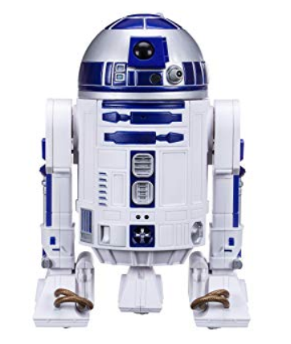
R2D2 Project Overview
1. Period
- April 29 ~ May 31
2. Goal
- Make a New Dome using 3D printer
- Make some parts move and display LED, LCD
3. Challenge
- Make many parts move
- Look more fancy
* Source - https://www.amazon.co.uk/Star-Wars-Smart-R2-D2-Playset/dp/B01L93GCTO

Slide 3
1st Week
1. Period
- April 29 ~ May 3
2. Task
- Research about R2D2 and 3D Printer
- Make a print list
- Print display parts and moving parts first
- Make demo for moving parts and display parts

Slide 4
Research
1.R2D2 & 3D printing reference site
1)R2D2 Builders club : http://astromech.net/
2) Mike Baddeley’s site: https://www.thingiverse.com/mrbaddeley/about
3) 3D Printed Droids : https://www.3dprinteddroids.net/
4) STL file viewer : https://www.viewstl.com/
5) 3D printer calibration - https://www.youtube.com/watch?v=JihFYdVnEj0
2.R2D2 3d printing file
1)Dome parts - https://www.thingiverse.com/thing:1395937/files
2)Hinges - https://astromech.technology/construction/s-dome-hinges/
→ Size is not fitted in Mike Baddeley’s Dome after all, so I had to cut a little.
Just use hinge files in Dome parts

Slide 5
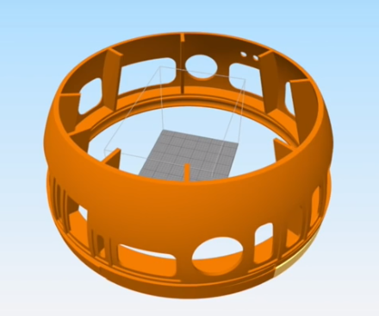
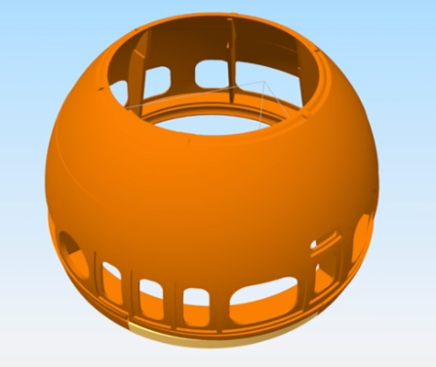
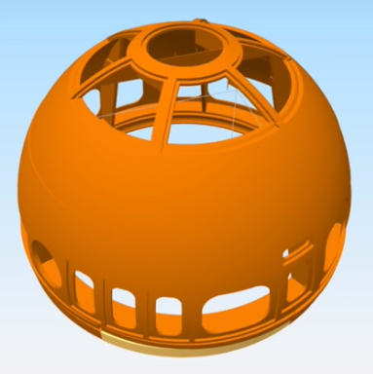
3D Print Overview
Domebase 9pcs
DomePie 6pcs
DomeTop 2pcs
Main 17pcs
+
Panel 14pcs
+
Others 16pcs
+
Hinge 36pcs+∝
=
Total 83pcs+∝
≒ 6pcs/hinge
* Captured image from : https://www.thingiverse.com/thing:1395937/files

Slide 6
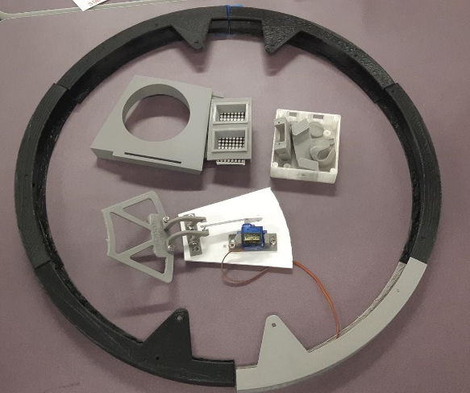
3D Print List
category |  | No | File Name | Size | Printed | LongTime | Priority
Dome | Holopro | 1 | holopro-part1.stl | 1307784 |  | O
 |  | 2 | holopro-part2.stl | 131584
 |  | 3 | holopro-part3.stl | 693884 |  | O
 |  | 4 | holopro-part4.stl | 969884 |  | O
 |  | 5 | HoloProv2.stl | 948884 |  | O
 | Panel | 6 | Panel10.stl | 94184
 |  | 7 | Panel11.stl | 90584
 |  | 8 | Panel12.stl | 92884
 |  | 9 | Panel13_lens.stl | 119984
 |  | 10 | Panel13.stl | 193284
 |  | 11 | Panel14.stl | 31884
 |  | 12 | Panel1.stl | 119684 | 5/1 |  | O
 |  | 13 | Panel2.stl | 64984 | 5/2
 |  | 14 | Panel3.stl | 403084
 |  | 15 | Panel4.stl | 684884 |  | O | O
 |  | 16 | Panel5.stl | 450984
 |  | 17 | Panel6.stl | 229384
 |  | 18 | Panel7.stl | 163184 |  |  | O
 |  | 19 | Panel8.stl | 32284
 |  | 20 | Panel9.stl | 240584
 | Base | 21 | R2D2DomeBase1.stl | 961484 |  | O | O
 |  | 22 | R2D2DomeBase2.stl | 645484 |  | O | O
 |  | 23 | R2D2DomeBase3.stl | 426284 |  |  | O
 |  | 24 | R2D2DomeBase4.stl | 485984 |  |  | O
 |  | 25 | R2D2DomeBase5-B.stl | 919184 |  | O | O
 |  | 26 | R2D2DomeBase5.stl | 754884 |  | O | O
 |  | 27 | R2D2DomeBase6.stl | 569384 |  | O | O
 |  | 28 | R2D2DomeBase7.stl | 1136984 |  | O | O
 |  | 29 | R2D2DomeBase7_ver_2.stl | 1106584 |  | O | O
 |  | 30 | R2D2DomeBase8.stl | 582084 |  |  | O
 |  | 31 | R2D2DomeBase9.stl | 1047684 |  | O | O
 | Pie | 32 | R2D2DomePie1.stl | 634784
 |  | 33 | R2D2DomePie2.stl | 510384
 |  | 34 | R2D2DomePie3.stl | 517384
 |  | 35 | R2D2DomePie4.stl | 578184
 |  | 36 | R2D2DomePie5.stl | 559684
 |  | 37 | R2D2DomePie6.stl | 465984
 |  | 38 | R2D2DomePie7_v2.stl | 712784 |  | O
 |  | 39 | R2D2DomePie8_v2.stl | 817984 |  | O
□ Printing Progress
Printed | Total | Progress(%)
12 | 83 | 14%
*Based on quantity
*Date : 5/2
□ Issues
- Difficult to calculate exact print time
- Extruder temperature problem
: Failed during 5/1 6pm ~ 5/2 2pm
☞ Couldn’t print anything
☞ Spent time to troubleshooting
➔ Exchanged the extruder(by Brian)

Slide 7
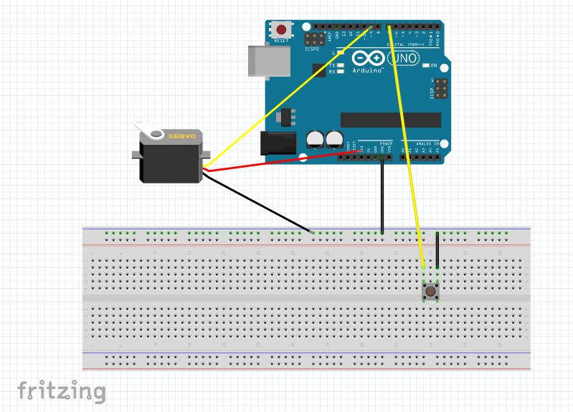
Moving Part - Circuit
- Servo motor
#include<Servo.h>
Servo servo;
int sw=7;
void setup(){
servo.attach(9);
pinMode(sw,INPUT_PULLUP);
}
void loop(){
if(digitalRead(sw)==HIGH){
servo.write(180);
}
else{
servo.write(0);
}}

Slide 8
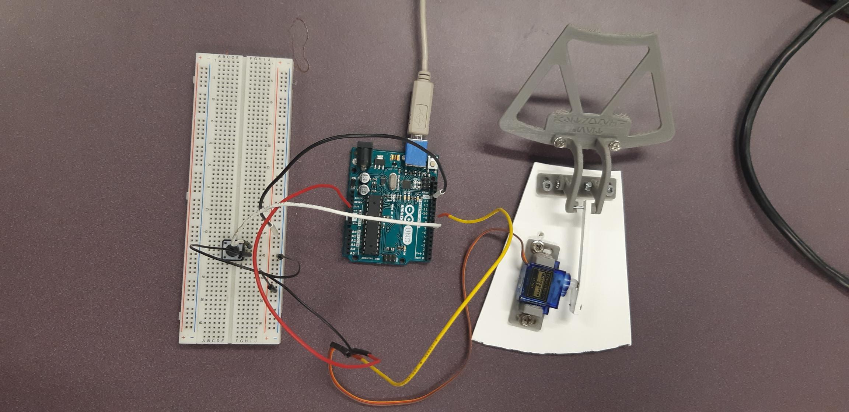
Moving Part - Demo
- Servo motor

Slide 9
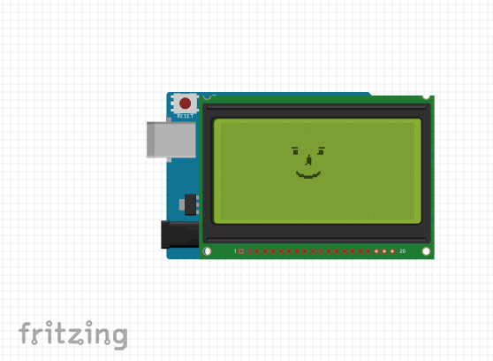
Display Part - TFT
- TFT LCD
#include <UTFT.h>
extern uint8_t SmallFont[];
// Declare an instance of the class
UTFT myGLCD(ITDB18SP,7,6,5,3,4);
void setup(){
randomSeed(analogRead(0));
// Setup the LCD
myGLCD.InitLCD(PORTRAIT);
myGLCD.setFont(SmallFont);
}
void loop()
{
byte buf[126];
int x, x2;
int y, y2;
int r;
*Source - http://www.elecfreaks.com/wiki/index.php?title=TFT1.8_LCD_Shield
(filename: UTFT_Demo_128*160_serial.pde)
[ Griff, Cathy ]

Slide 10
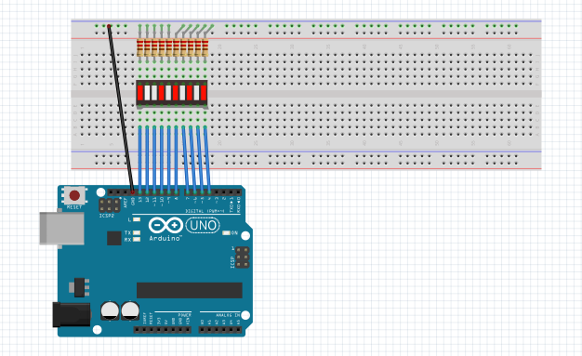
Display Part – LED
- LED Bar
void setup() {
pinMode(13, OUTPUT); //define pins as output
pinMode(12, OUTPUT);
pinMode(11, OUTPUT);
pinMode(10, OUTPUT);
pinMode(9, OUTPUT);
pinMode(8, OUTPUT);
pinMode(7, OUTPUT);
pinMode(6, OUTPUT);
pinMode(5, OUTPUT);
pinMode(4, OUTPUT);
}
void loop() {
unsigned int strobespeed = 150; //change for a different strobe speed
digitalWrite(4, HIGH);
delay(strobespeed);
digitalWrite(4, LOW);
digitalWrite(5, HIGH);
delay(strobespeed);
digitalWrite(5, LOW);
digitalWrite(6, HIGH);
delay(strobespeed);
digitalWrite(6, LOW);
[ Rex, Orlin, Cathy ]
*Source - http://www.learningaboutelectronics.com/Articles/10-segment-LED-bar-graph-circuit-with-an-arduino.php

Slide 11
Plan for 2nd week
1. Period
- May 6 ~ May 10
2. Plan
- Print progress up to 40%
- Make a plan how to put together (glue/welding, painting)
- Make an idea(at least 2) for fancy R2D2 and apply them for displaying

Slide 12
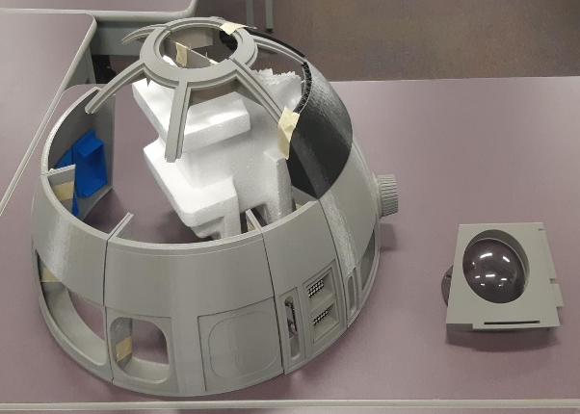
3D Print List
□ 3D printing List
category |  | No | File Name | Size | Printed | LongTime | Priority
Dome | Holopro | 1 | holopro-part1.stl | 1307784 |  | O
 |  | 2 | holopro-part2.stl | 131584
 |  | 3 | holopro-part3.stl | 693884 |  | O
 |  | 4 | holopro-part4.stl | 969884 |  | O
 |  | 5 | HoloProv2.stl | 948884 | 5/6 | O
 | Panel | 6 | Panel10.stl | 94184 | 5/9
 |  | 7 | Panel11.stl | 90584
 |  | 8 | Panel12.stl | 92884
 |  | 9 | Panel13_lens.stl | 119984
 |  | 10 | Panel13.stl | 193284
 |  | 11 | Panel14.stl | 31884 | 5/9 |  | O
 |  | 12 | Panel1.stl | 119684 | 5/1 |  | O
 |  | 13 | Panel2.stl | 64984 | 5/2
 |  | 14 | Panel3.stl | 403084 | 5/9
 |  | 15 | Panel4.stl | 684884 |  | O | O
 |  | 16 | Panel5.stl | 450984
 |  | 17 | Panel6.stl | 229384
 |  | 18 | Panel7.stl | 163184 | 5/7 |  | O
 |  | 19 | Panel8.stl | 32284 | 5/9
 |  | 20 | Panel9.stl | 240584 | 5/9
 | Base | 21 | R2D2DomeBase1.stl | 961484 | 5/4 | O | O
 |  | 22 | R2D2DomeBase2.stl | 645484 | 5/4 | O | O
 |  | 23 | R2D2DomeBase3.stl | 426284 | 5/8 |  | O
 |  | 24 | R2D2DomeBase4.stl | 485984 |  |  | O
 |  | 25 | R2D2DomeBase5-B.stl | 919184 | 5/8 | O | O
 |  | 26 | R2D2DomeBase5.stl | 754884 |  | O | O
 |  | 27 | R2D2DomeBase6.stl | 569384 | 5/9 | O | O
 |  | 28 | R2D2DomeBase7.stl | 1136984 |  | O | O
 |  | 29 | R2D2DomeBase7_ver_2.stl | 1106584 |  | O | O
 |  | 30 | R2D2DomeBase8.stl | 582084 |  |  | O
 |  | 31 | R2D2DomeBase9.stl | 1047684 | 5/7 | O | O
 | Pie | 32 | R2D2DomePie1.stl | 634784
 |  | 33 | R2D2DomePie2.stl | 510384
□ Printing Progress
Printed | Total | Progress(%)
26 | 83 | 31%
*Based on quantity
*Date : 5/10
□ Issues
- Printed big size first(dome base part)
: took a lot of time
- Started printing panel as blue color
- Need extra tape

Slide 13
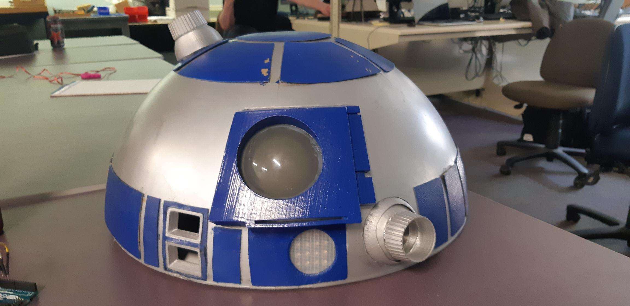
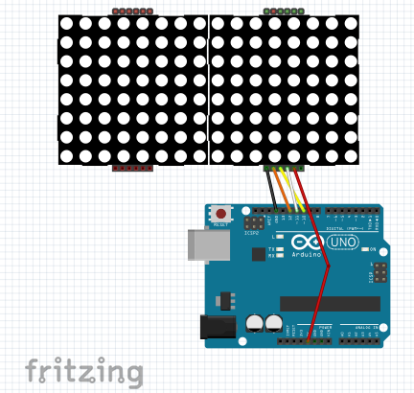
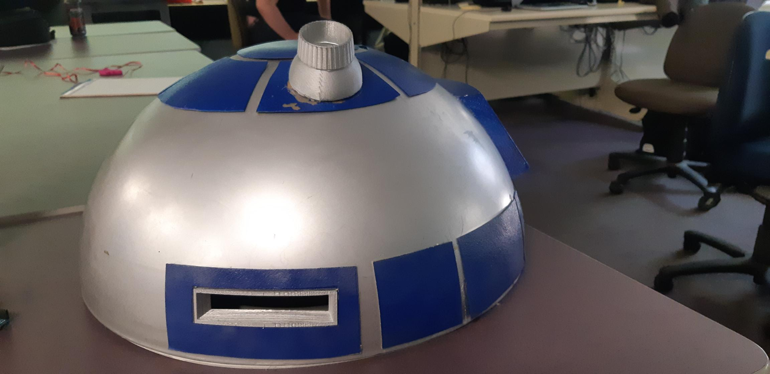
Plan for Display
Front Logic Display
1. Name : Front Logic display
4
2 squares (1.5inch x 1inch)
1in
3
1
1.5in
2
2. How to display
1) LED Matrix
: Generate scattered
LED light randomly
6
5

Slide 14
Plan for Display
Processor State Indicators(PSI)
1. Name : Processor State Indicators(PSI)
4
1.7in
- Diameter : 1.7inch
3
1
2
2. How to display
1) RGB LED
- Use original one
- Keep changing color
6
5

Slide 15
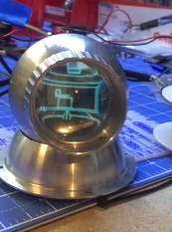
Plan for Display
Holoprojector(side)
1. Name : Holoprojector (Side)
1.5in
4
- Size : 1.5inch
3
Ex) Hologram (OLED)
1
2
2. How to display
1) TFT LCD Display
: Random Display
3. Idea (with Orlin, Neil, Rex)
1) Attach Convex/Concave Lens or Magnifier
2) Making move
6
5

Slide 16
Plan for Display
Radar Eye
1. Name : Radar Eye
4
3
- Diameter : 3inch
3in
1
2
2. How to display
1) Attach plastic dome
3. Idea
- Light?
- Camera?
6
5

Slide 17
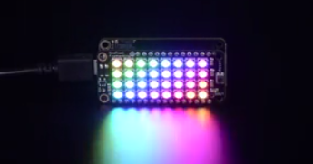
Plan for Display
Rear Logic Display
1. Name : Rear Logic Display
4.3in
4
1in
- Size : 1.5inch
3
1
2
2. How to display
1) LED will arrive at May 13th
2) NeoPixel(RGB LED)
6
5
https://www.adafruit.com/?q=neopixel&p=2

Slide 18
Plan for Display
Holoprojector(upper)
1. Holoprojector (Upper)
1.5in
4
- Size : 1.5inch
3
1
2
2. Ideas about how to display (by Rex)
1) Use Lithonia LED Lighting (12v, 0.23amp)
① Only LED
② Add Convex or Concave Lens
: Link
③ Attach something to make color
ex) cellophane(risk to burn?)
2) Use spotlight
6
5

Slide 19
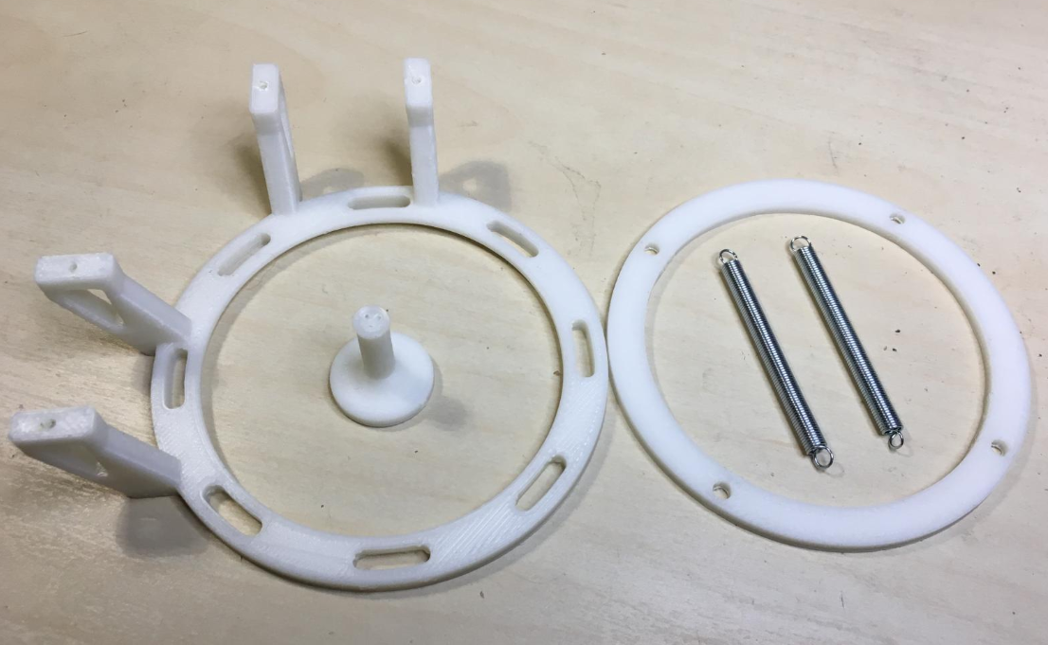
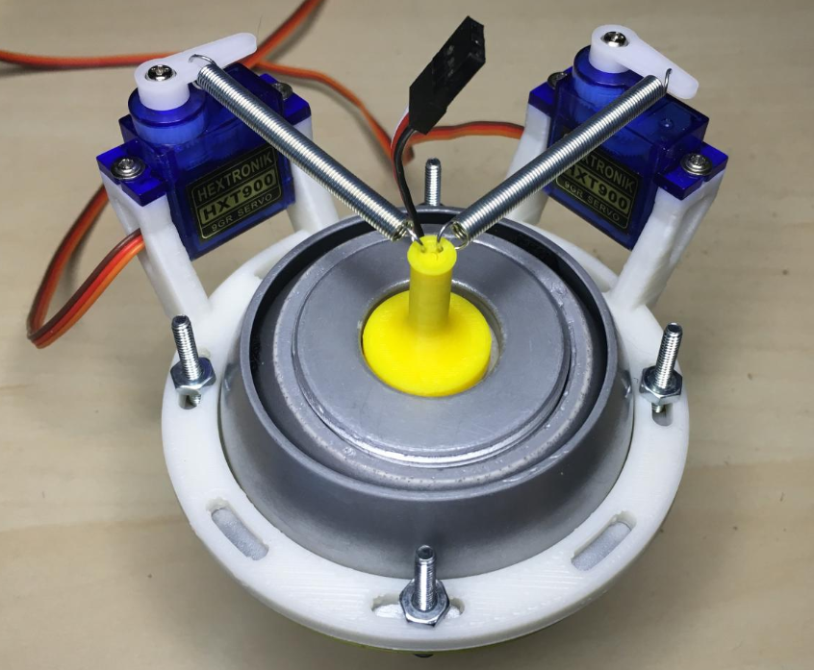
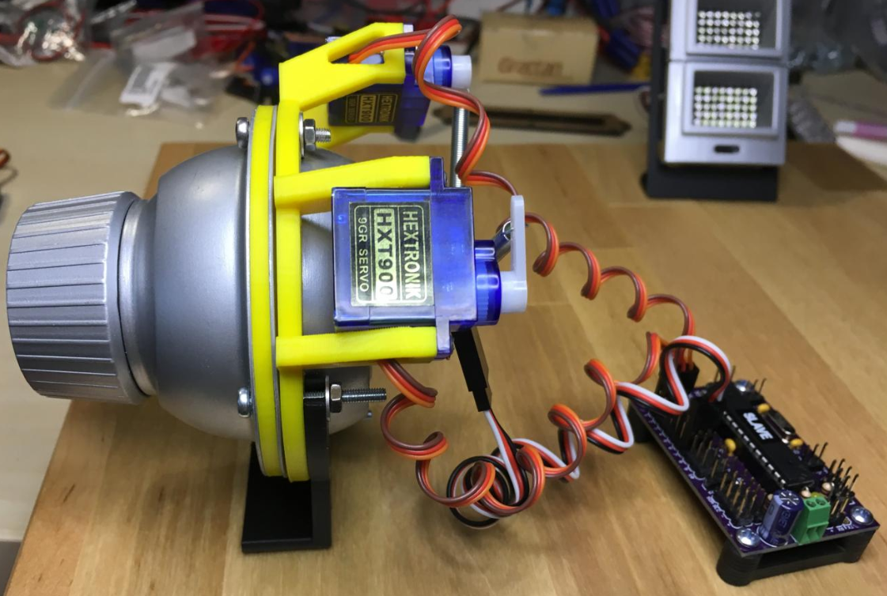
Plan for Moving Parts
Holoprojector
1. Parts : 2servo motors, plastic pieces, 2 springs
- Plastic Pieces : Print using 3D printer
- 2 Spring : need alternative one
http://astromech.net/forums/showthread.php?30196-Mowee%92s-HP-control-system-BC-Approved-Continuous-Various-(Nov-2016)-Open&p=407390#post407390

Slide 20
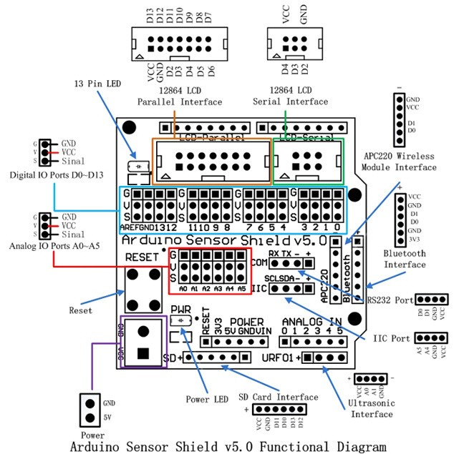
Plan for Moving Parts
Total
1. Multi-Motor control using by sensor shield
- 11 panels or 9 panels / 1 holoprojector

Slide 21
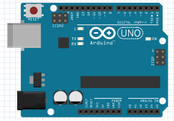
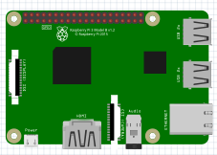


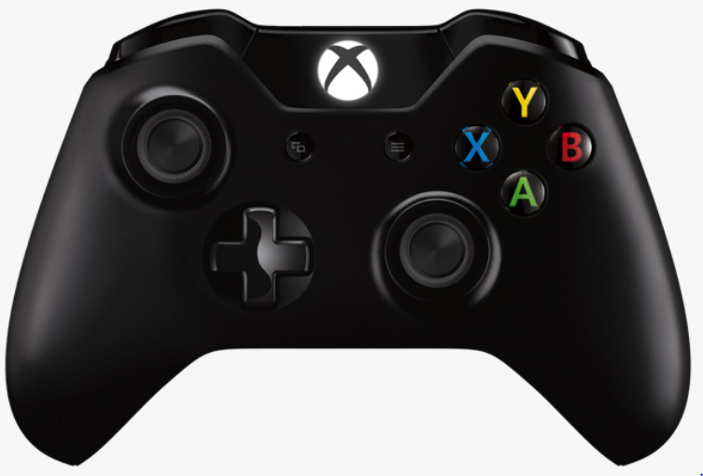
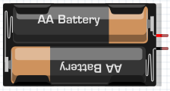
Design how to work
Plan 1
DOME
BODY
[ 3 Arduino + 1 Raspberry Pi ]
Servo
Motors
(11ea)
Body Pi
Remote
Controller
Dome Pi
TFT-LCD
LED Matrix
Power
LED Display
LCD Display

Slide 22
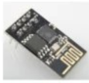
Design how to work
Plan 2
DOME
BODY
[ 3 Arduino (+ wifi modules) + Raspberry Pi ]
Servo
Motors
(11ea)
Wireless
Connection
Body Pi
Remote
Controller
Wifi module
TFT-LCD
LED Matrix
LED Display
Power
LCD Display

Slide 23
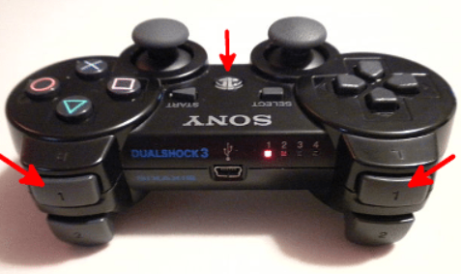
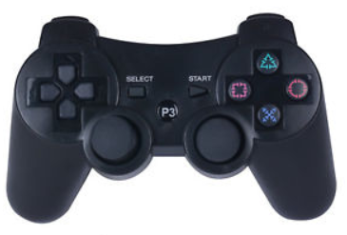
Remote Controller Button
P3
- Use pygame program
K_x(up)
K_v(up)
K_z(down)
K_c(down)
K_9
K_10
K_1
K_5
K_4
K_2
K_8
K_6
K_3
K_7
K_B
K_UP/DOWN
K_LEFT/RIGHT
Axis1/2 Axis3/4

Slide 24
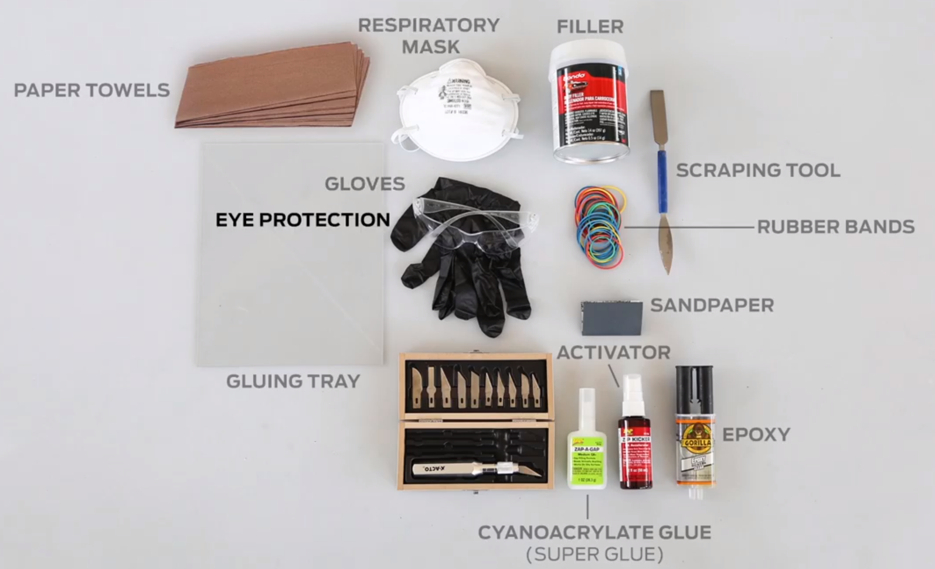
Plan for Appearance
PartⅠ. Assembly
1. Material : PLA (filament) - Organic material like corn starch and sugar cane
2. Parts : Filler, Sand Paper/Sanding Machine, Epoxy resin, Superglue
√ Filler
√ Sand Paper/ Sanding Machine
√ Epoxy
√ Super Glue
*Source - https://www.youtube.com/watch?v=k-sR1wxz-bw

Slide 25
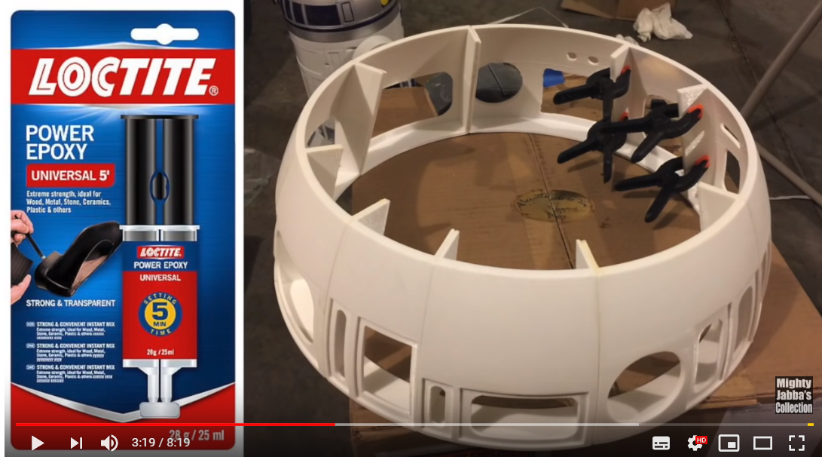
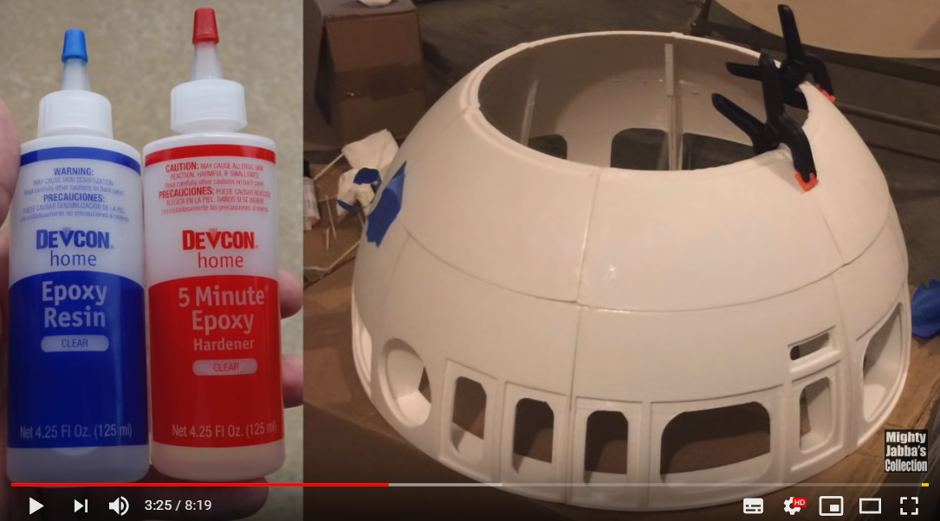
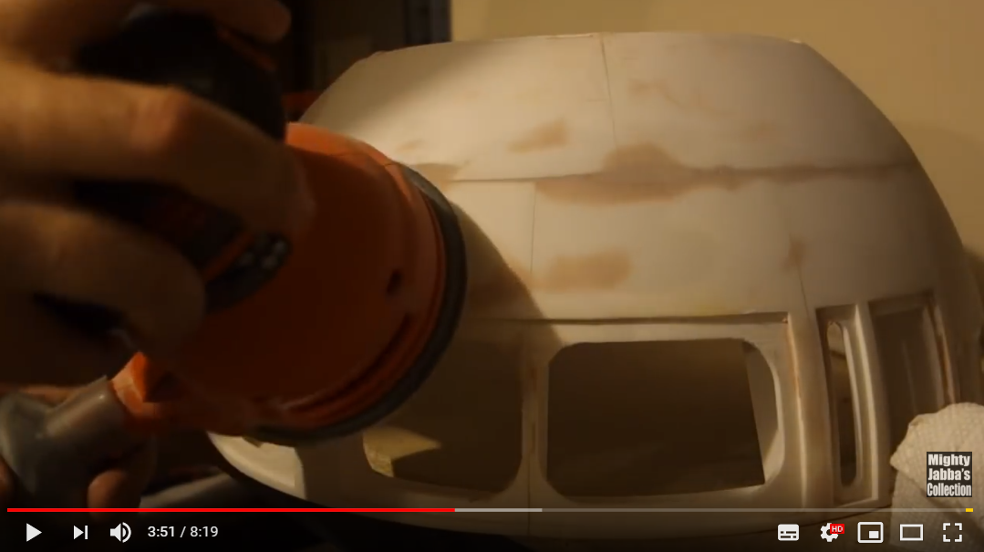
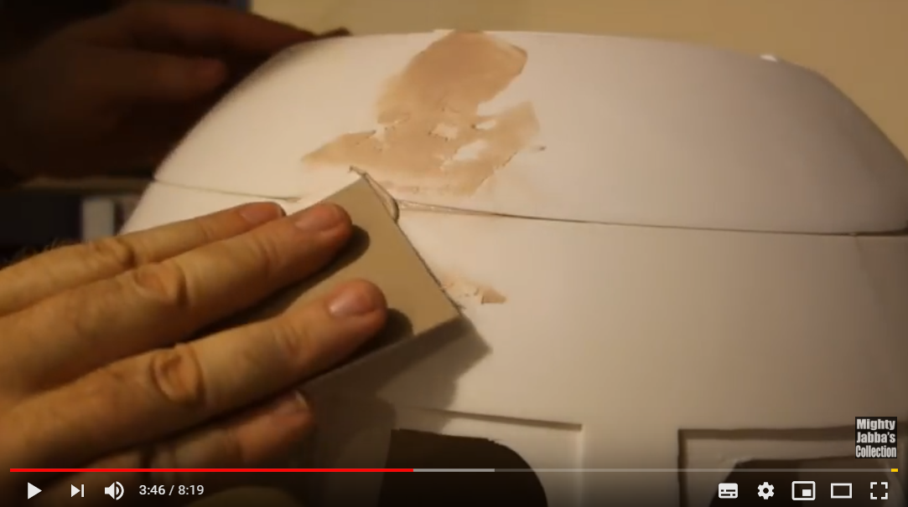
Plan for Appearance
PartⅠ. Assembly
1. pre-fix parts (Supurglue)
2. Fixing Dome (Epoxy Resin)
4. Make it smooth(Sander)
3. Filling gaps between parts (Filler)
https://www.youtube.com/watch?v=3WcUO5BmH0w&feature=youtu.be

Slide 26
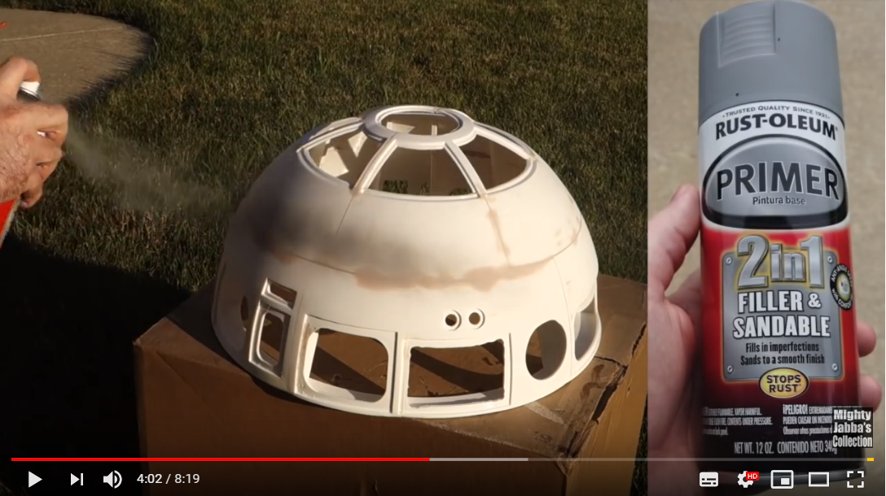
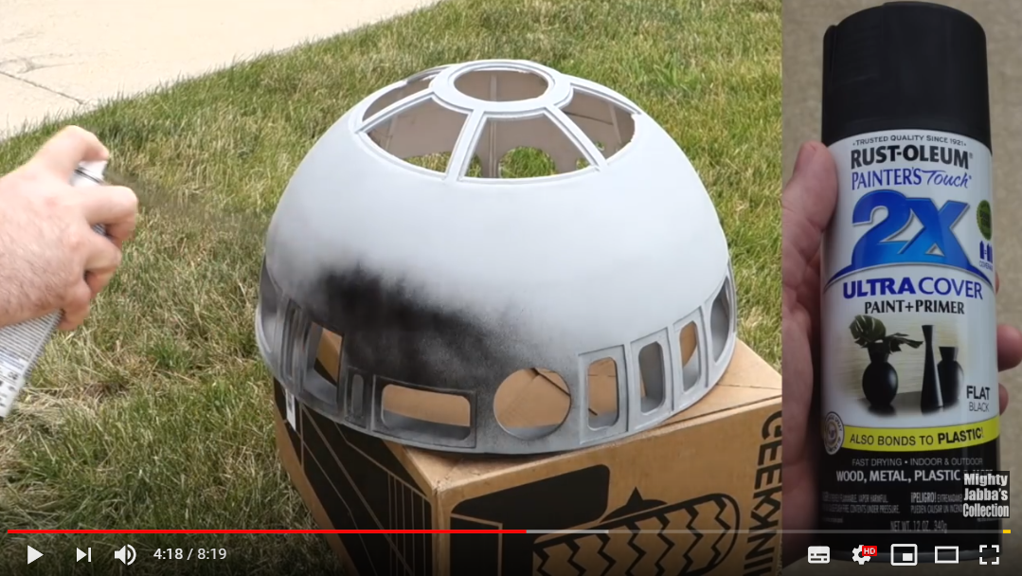
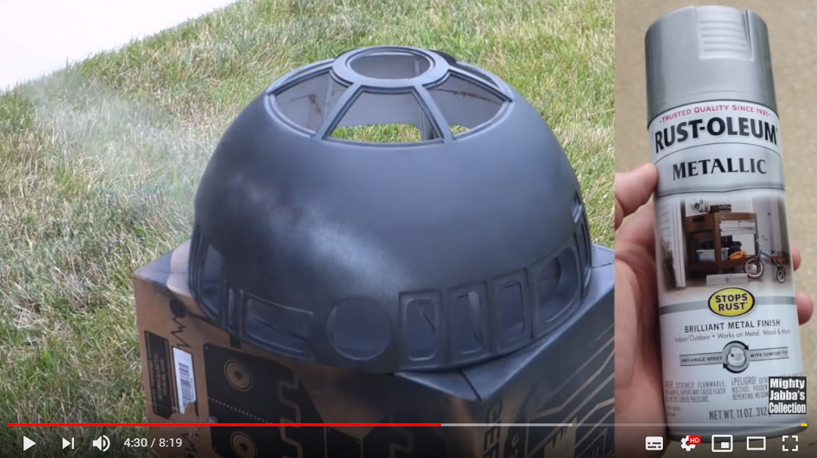
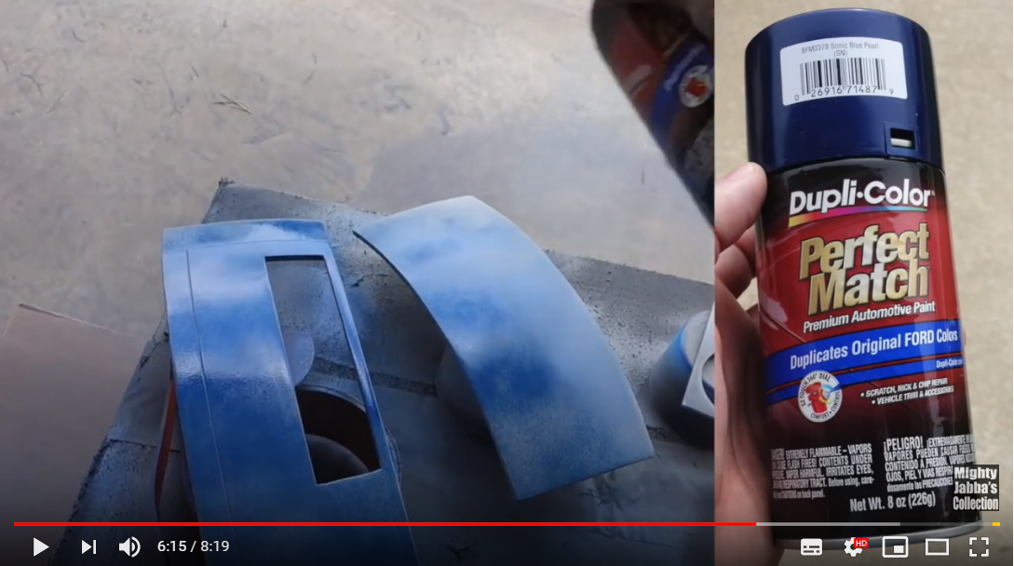
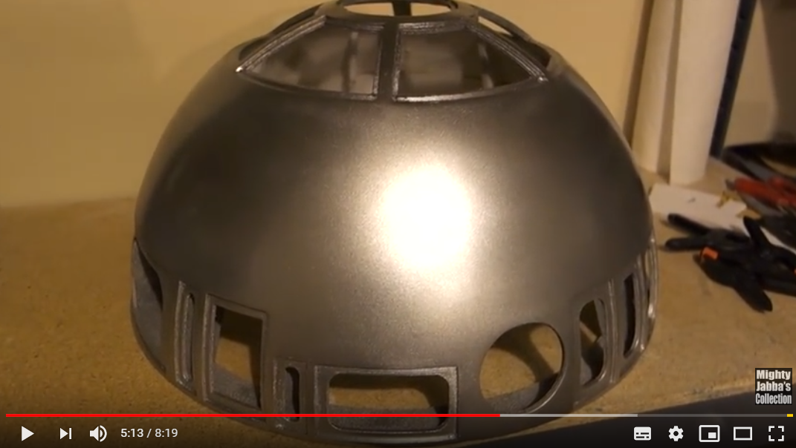
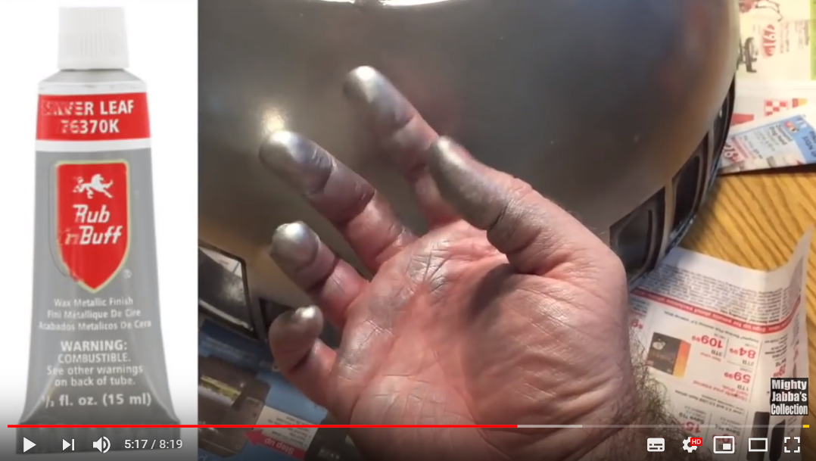
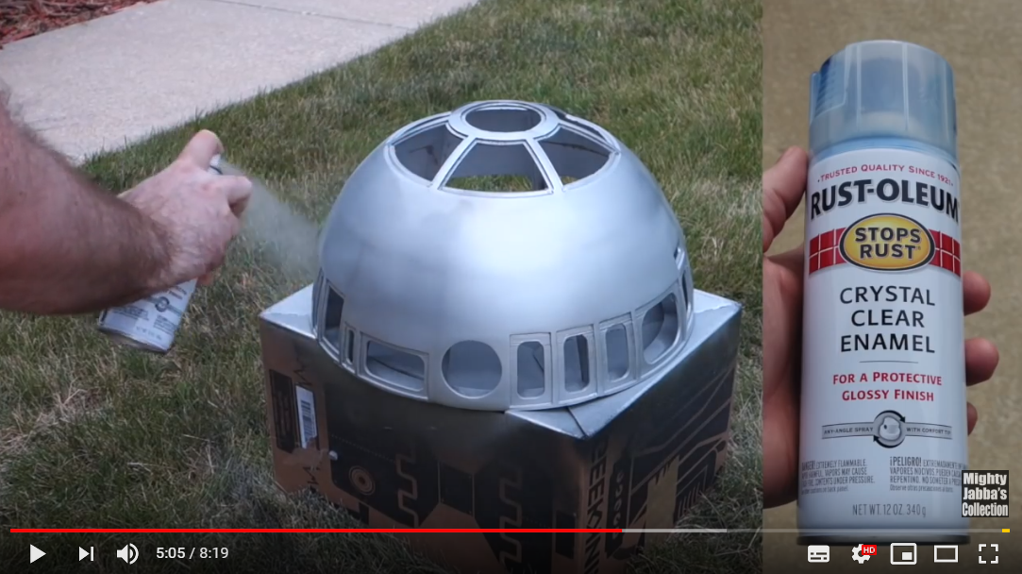
Plan for Appearance
PartⅡ. Painting
1. Parts : 5~6 sprays(Primer, PainterTouch, Metallic, Crystal Clear Enamel, Rub n Buff, Blue Pearl)
1. Filling some imperfection (Primer)
2. Black base coat (PainterTouch)
: Helpful for metallic paint
3. Silver coat (Metallic spray)
6. Blue Pearl coat for panel
(Blue spray)
5. Wax with aluminum powder
(Rub n Buff) look metallic!!
4. Protect the paint, make it more glossy
(Crystal Clear Enamel)
https://www.youtube.com/watch?v=3WcUO5BmH0w&feature=youtu.be

Slide 27
Plan for 3rd week
1. Period
- May 13 ~ May 17
2. Plan
- Finish printing for main dome part → start to assembly
- Design electronic part for dome and connection with body
: How to connect Raspberry Pi with Arduino
: How to connect 2 Raspberry Pi
: How to control Dome by remote controller
- Display using RPi LCD display
- Brain storming for another idea (Camera, Sound)

Slide 28
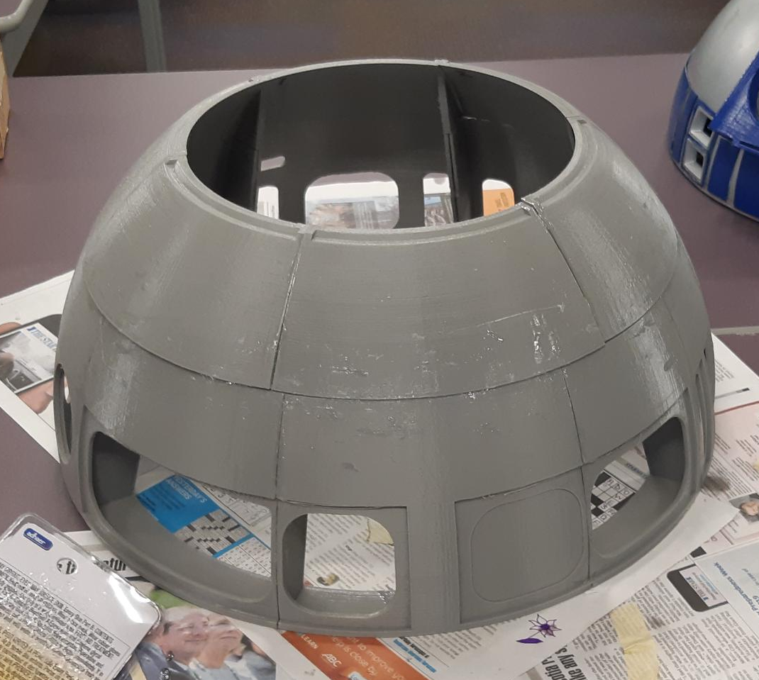
3D Print Progress
□ 3D printing List
Category |  | No | File Name | Size | Printed | LongTime | Priority
Dome | Holopro | 1 | holopro-part1.stl | 1307784 |  | O
 |  | 2 | holopro-part2.stl | 131584
 |  | 3 | holopro-part3.stl | 693884 |  | O
 |  | 4 | holopro-part4.stl | 969884 |  | O
 |  | 5 | HoloProv2.stl | 948884 | 5/6 | O
 | Panel | 6 | Panel10.stl | 94184 | 5/9
 |  | 7 | Panel11.stl | 90584 | 5/17
 |  | 8 | Panel12.stl | 92884
 |  | 9 | Panel13_lens.stl | 119984
 |  | 10 | Panel13.stl | 193284
 |  | 11 | Panel14.stl | 31884 | 5/9 |  | O
 |  | 12 | Panel1.stl | 119684 | 5/1 |  | O
 |  | 13 | Panel2.stl | 64984 | 5/2
 |  | 14 | Panel3.stl | 403084 | 5/9
 |  | 15 | Panel4.stl | 684884 | 5/16 | O | O
 |  | 16 | Panel5.stl | 450984 | 5/13
 |  | 17 | Panel6.stl | 229384 | 5/17
 |  | 18 | Panel7.stl | 163184 | 5/7 |  | O
 |  | 19 | Panel8.stl | 32284 | 5/9
 |  | 20 | Panel9.stl | 240584 | 5/9
 | Base | 21 | R2D2DomeBase1.stl | 961484 | 5/4 | O | O
 |  | 22 | R2D2DomeBase2.stl | 645484 | 5/4 | O | O
 |  | 23 | R2D2DomeBase3.stl | 426284 | 5/8 |  | O
 |  | 24 | R2D2DomeBase4.stl | 485984 | 5/13 |  | O
 |  | 25 | R2D2DomeBase5-B.stl | 919184 | 5/8 | O | O
 |  | 26 | R2D2DomeBase5.stl | 754884 |  | O | O
 |  | 27 | R2D2DomeBase6.stl | 569384 | 5/9 | O | O
 |  | 28 | R2D2DomeBase7.stl | 1136984 | 5/9 | O | O
 |  | 29 | R2D2DomeBase7_ver_2.stl | 1106584 |  | O | O
 |  | 30 | R2D2DomeBase8.stl | 582084 | 5/11 |  | O
 |  | 31 | R2D2DomeBase9.stl | 1047684 | 5/7 | O | O
 | Pie | 32 | R2D2DomePie1.stl | 634784 | 5/15
 |  | 33 | R2D2DomePie2.stl | 510384 | 5/14
 |  | 34 | R2D2DomePie3.stl | 517384 | 5/14
□ Printing Progress
Printed | Total | Progress(%)
39 | 83 | 47%
*Based on quantity
*Date : 5/17
□ Issues
- Finished printing main dome
: Started to attach main parts

Slide 29
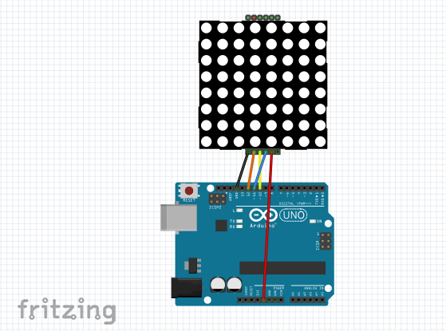
LED Blinking
[ Pin Connection ]
5V : 2, 4
GND : 6, 9, 14, 20, 25
DataInput(MOSI) : 19 (Arduino 12)
SCK(CLK) : 23 (Arduino 11)
CE0CS : 24 (Arduino 10)

Slide 30
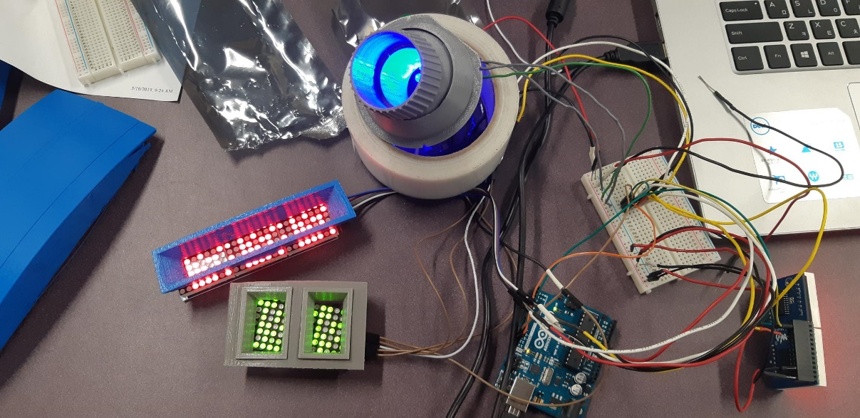
LED Blinking
LED Blinking Display
- Make a blink using one Arduino
(RED – GREEN – RED – GREEN)
GREEN
RED
GREEN
RED

Slide 31
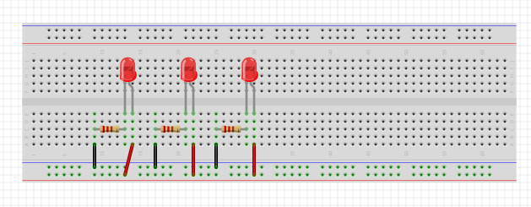
LED Circuit board
Make an own LED circuit board
( ∵ no proper LED size)
BLUE Light
GND
5V

Slide 32
Made a Connection
We made a connection remote controller → Body Pi → Dome Pi → Arduino
Need to make connection multi Arduino at the same time
DOME
BODY
Servo
Motors
(11ea)
Remote
Controller
Dome Pi
Body Pi
TFT-LCD
LED Matrix
Power
LED Display
LCD Display

Slide 33
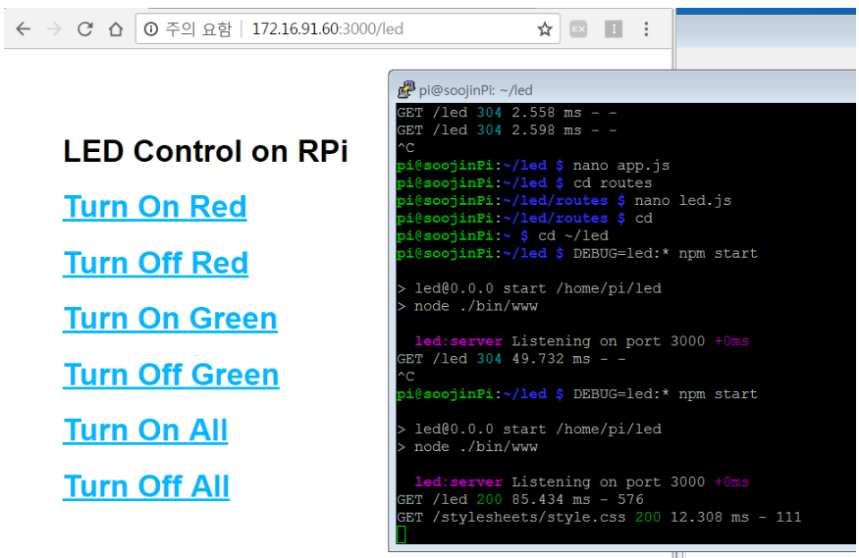
For fun) LED Blink using Server
- Make a server and click command → LED Blink
https://blog.naver.com/sj950914/221362167344

Slide 34
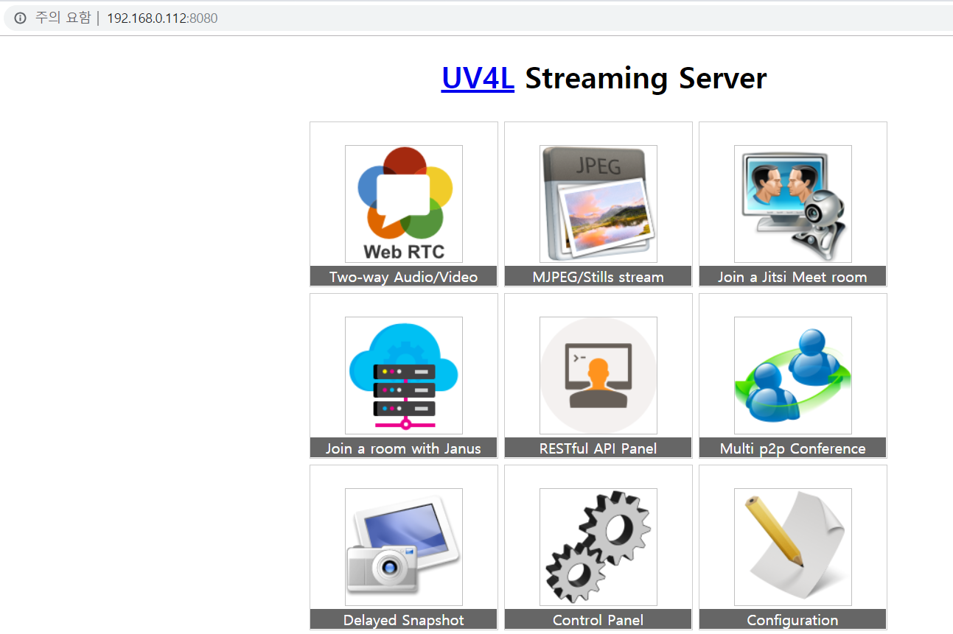
For fun) Camera
Connect camera, take a picture, save videos
Made streaming service using server
https://cosmosjs.blog.me/221339215946

Slide 35
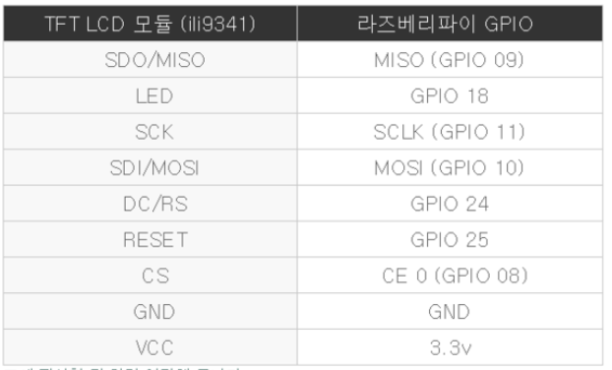
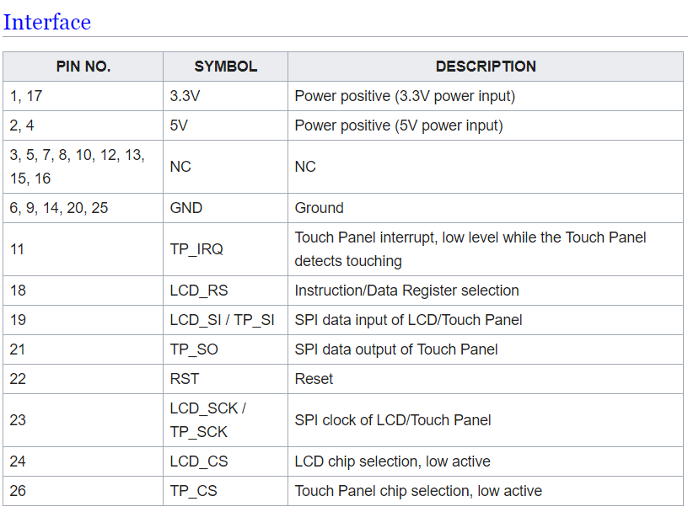
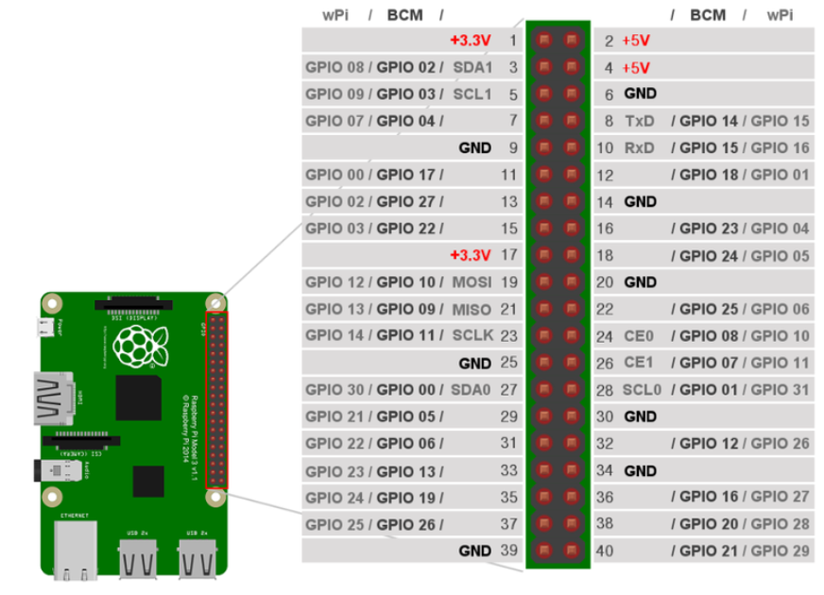
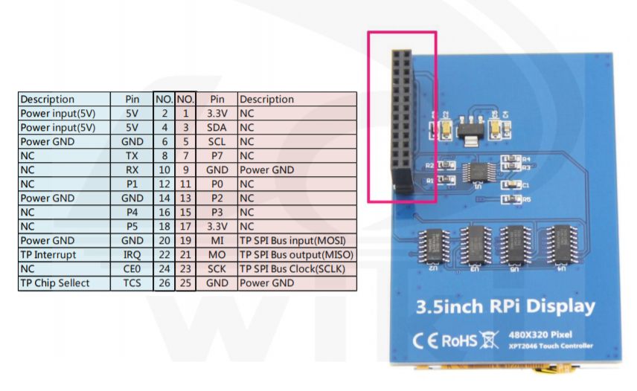
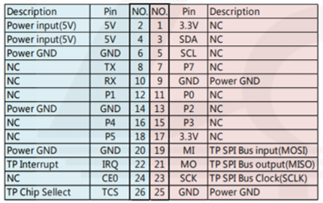
Reference. Information about pin
Raspberry Pi
LED Matrix
17 – 17 (3.3)
21 – 21 (MISO)
22 – 22 (reset)??
23 – 23 (SCK)
24 – 24 (CE0)
25 – 25 (GND)

Slide 36
Plan for 4rd week
1. Period
- May 21 ~ May 24 (May 20th is holiday)
2. Plan
- Finish assembly for main dome part → start to paint
- Make connection multi Arduino at the same time
- Display using RPi LCD display (StarWars Font)
- Making a decision for Radar Eye part (camera or light?)

Slide 37
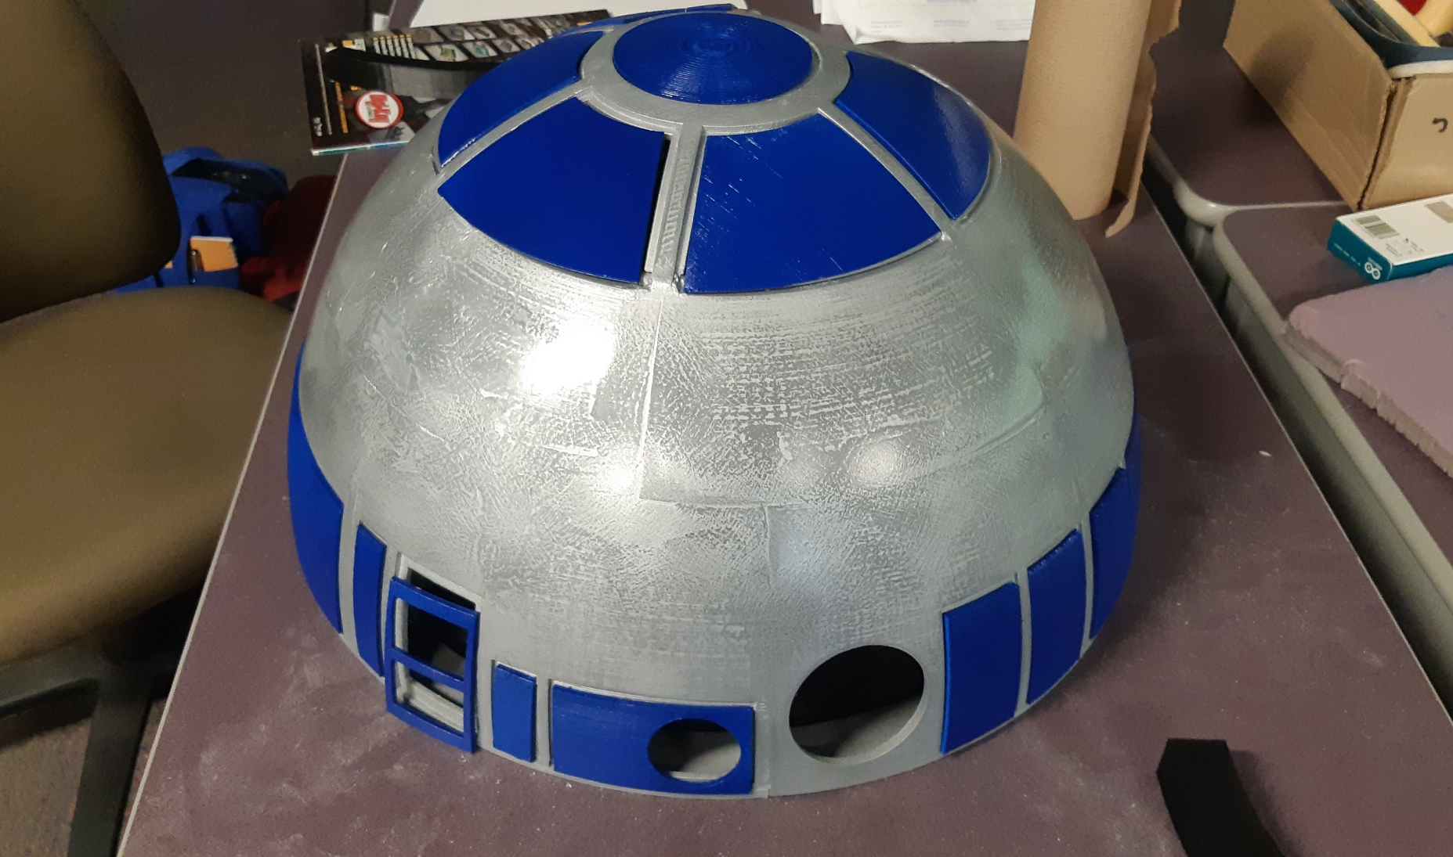
Painting
- Attaching → Filler → Primer

Slide 38


LED Blinking
- Making some parts(edge) which is blocked do not blink (for efficiency)

Slide 39


LED Blinking
- Making some parts(edge) which is blocked do not blink (for efficiency)

Slide 40




LED Circuit Board
- Making an own circuit board

Slide 41


LCD Display
Make display(using 3.5’’ RPI LCD Display)
: Making a video by ppt, and display it

Slide 42
Plan for 5rd week
1. Period
- May 27 ~ May 31
2. Plan
- Finishing all parts
- Check connection between Dome Pi <-> Body Pi
- Check all of features using remote control

Slide 43

3D Print Progress
□ 3D printing List
Category |  | No | File Name | Size | Printed | LongTime | Priority
Dome | Holopro | 1 | holopro-part1.stl | 1307784 |  | O
 |  | 2 | holopro-part2.stl | 131584
 |  | 3 | holopro-part3.stl | 693884 |  | O
 |  | 4 | holopro-part4.stl | 969884 |  | O
 |  | 5 | HoloProv2.stl | 948884 | 5/6 | O | 5*3ea
 | Panel | 6 | Panel10.stl | 94184 | 5/9
 |  | 7 | Panel11.stl | 90584 | 5/17
 |  | 8 | Panel12.stl | 92884 | 5/21
 |  | 9 | Panel13_lens.stl | 119984
 |  | 10 | Panel13.stl | 193284 | 5/21
 |  | 11 | Panel14.stl | 31884 | 5/9 |  | O
 |  | 12 | Panel1.stl | 119684 | 5/1 |  | O
 |  | 13 | Panel2.stl | 64984 | 5/2
 |  | 14 | Panel3.stl | 403084 | 5/9
 |  | 15 | Panel4.stl | 684884 | 5/16 | O | O
 |  | 16 | Panel5.stl | 450984 | 5/13
 |  | 17 | Panel6.stl | 229384 | 5/17
 |  | 18 | Panel7.stl | 163184 | 5/7 |  | O
 |  | 19 | Panel8.stl | 32284 | 5/9
 |  | 20 | Panel9.stl | 240584 | 5/9
 | Base | 21 | R2D2DomeBase1.stl | 961484 | 5/4 | O | O
 |  | 22 | R2D2DomeBase2.stl | 645484 | 5/4 | O | O
 |  | 23 | R2D2DomeBase3.stl | 426284 | 5/8 |  | O
 |  | 24 | R2D2DomeBase4.stl | 485984 | 5/13 |  | O
 |  | 25 | R2D2DomeBase5-B.stl | 919184 | 5/8 | O | O
 |  | 26 | R2D2DomeBase5.stl | 754884 |  | O | O
 |  | 27 | R2D2DomeBase6.stl | 569384 | 5/9 | O | O
 |  | 28 | R2D2DomeBase7.stl | 1136984 | 5/9 | O | O
 |  | 29 | R2D2DomeBase7_ver_2.stl | 1106584 |  | O | O
 |  | 30 | R2D2DomeBase8.stl | 582084 | 5/11 |  | O
 |  | 31 | R2D2DomeBase9.stl | 1047684 | 5/7 | O | O
 | Pie | 32 | R2D2DomePie1.stl | 634784 | 5/15
□ Printing Progress
Printed | Total | Progress(%)
83 | 83 | 100%
We printed 84pcs, total time was approximately
245hours

Slide 44



Movement for Holo Projector
- Movement for holoprojector using servo motor
: plan – use 2 motors → change – use 1 motor
(∵ Don’t have spring, 2 motors are interrupted each other)
Plan
Applied in real
https://astromech.net/forums/showthread.php?30196-Mowee%92s-HP-control-system-BC-Approved-Continuous-Various-(Nov-2016)-Open&p=407390

Slide 45
Connection between 2 RPi
Connection by wifi
- Made a connection by wifi, they talk to each other UDP address and PORT
- But, Original body raspberry pi was 2 version, so it doesn’t have wifi module
So we changed plan (using ADHOC)
2. Connection by static ip (ADHOC)
- Made a connection by ADHOC

